Slide 1


Gensenders that go into Church Planting
Notes:
This is a report I prepared to try to answer the question of how effective the GenSend program has been in identifying and recruiting church planters.
I have drawn this data from RAP, Dynamics, and Send Relief. I had the help from Chris Johnson from Improve Atlanta, thanks to Roger Robb.

Slide 2
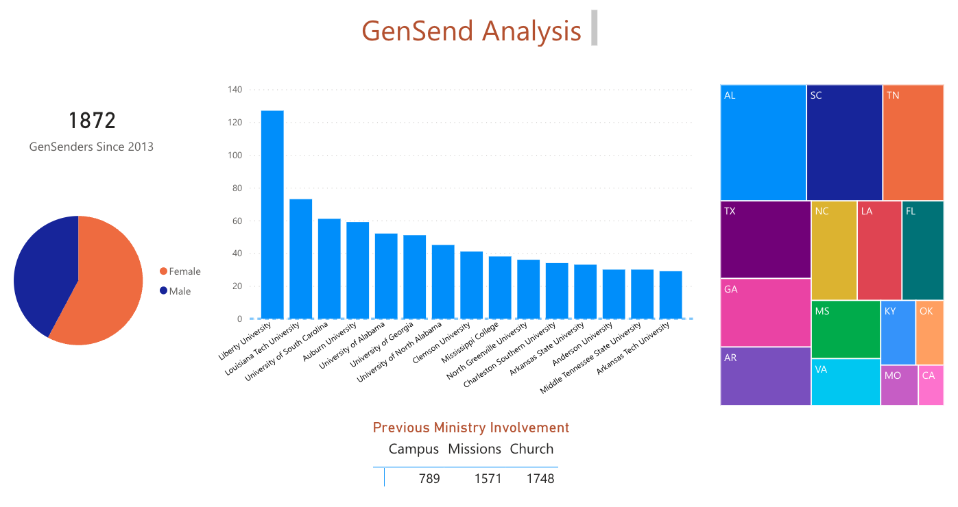
Notes:
This is what we know about GenSenders:
Since 2013 close to 1900 students have applied and served through GenSend. 58% of participants have been females and 42% males.
The most popular schools among GenSenders are Liberty, Louisiana Tech, the University of South Carolina, and Auburn University.
Half of GenSenders come from four states: Alabama, South Carolina, Tennessee, and Texas.
Most GenSenders have served in missions or church ministry prior to their GenSend experience. Less than half have been involved in campus ministry.

Slide 3
Former GenSenders who are or have been involved in Church Planting:
22
9 girls, 13 guys
Mostly CPTM’s
3 Lead Church Planters
1 Church Planter Apprentice
2 Church Plating Interns
Notes:
1. To find GenSenders who are or have been involved in Church Planting I looked through our database for people who had ”GenSend” and “Church Plant” memberships in their records,
2. And found 22 students out of the 1,872.
3. This is how the 22 are broken down. Most of them are Church Planting Team Members and only a handful have gone into church planting.

Slide 4
6 out of 1,872
3.1%
2023 Send Network Orientation
CPA Andrew Cheatham
Notes:
Six people out of 1,872 GenSenders! 3.1%
At this point I had searched everywhere and could not find better news… until:
I met a Church Planter Apprentice from Ft. Worth, TX named Andrew Cheatham at the Send Network Orientation last March and he told me he had been a GenSender along with a few others who are pursuing Church Planting with NAMB.
I looked them up in our records and noticed that they were not listed under the “GenSend” membership category. According to Steve Turner the terms “GenSender” and “Student Missionary” used interchangeably back then

Slide 5
GenSenders, student missionaries, and journeymen
1,533 STUDENT MISSIONARIES
Notes:
So I expanded my search to include not only those with the “GenSender” membership, but also student missionaries, and journeymen. The results were more encouraging.
I found 1,533 short- and long-term Student Missionaries and Journeymen who have served. Unfortunately, the information we have on these missionaries is very

Slide 6
Out of a total of 3,405 GenSenders, student missionaries, and journeymen
45
11 girls, 34 guys
Mostly CPTM’s
20 LCP’s, 3 CPA’s, & 3 CPI’s
Notes:
1. Out of a total of 3,405 GenSenders, student missionaries, and journeymen
Fourty-five were involved in church planting the last 10 years.

Slide 7
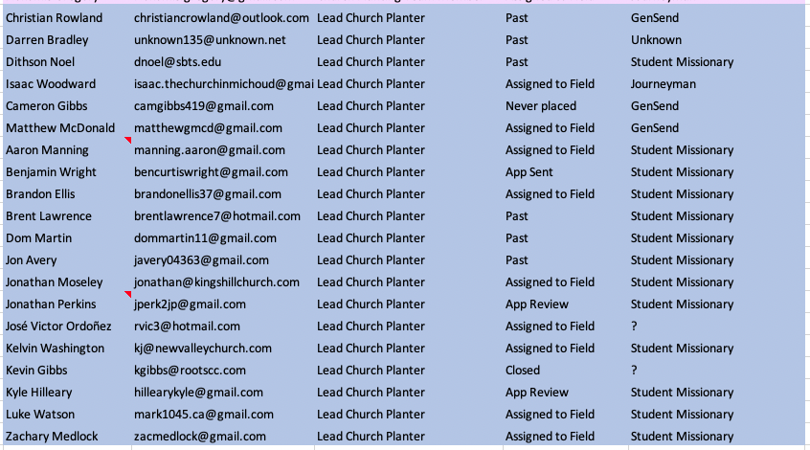
Notes:
Here it is, 20 planters

Slide 8
20 out of 3,405
1.7%
Notes:
A few take-aways:
- With the lack of differentiation between GenSenders and Student Missionaries, it is difficult to know who to include in the count
Present this data to Chad and Steve Turner
Ask Chris if more info is available on “CRM Query_Other Student Categories”
Ask Roger if Stacey’s Team will do a phone survey of former GenSenders
CRM query for other student categories saved in Advanced View – Memberships under “Former GenSenders & Student Missionaries”
After meeting in Steve Turner on 7/11/23:
Steve suggested adding a question about follow up after GenSend experience: We’d love to stay connected with you.
Judy and Steve could write the survey.
Perform a longitudinal study (3 years, 5 years). Where do they end up?
Getting the second generation to move back to the city to plant. First generation was accidental. Second generation will be more specific.

